Slide 1
An Introduction to Analyzing Hate Speech
Disclaimer: The following presentation contains materials that can be upsetting for some. As the following contains real world examples of hate speech, viewers are recommended to proceed with caution.

Slide 2
Understanding hate speech
A brief introduction into online hate speech with special focus on its definition, appearance, and online distribution.

Slide 3
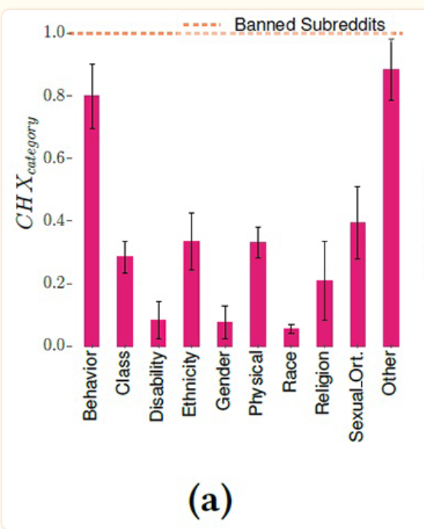
Definitions
Hate speech is targeted language whose purpose is to propose or incite violence upon an individual or individuals.
Oftentimes hate speech employs specific terms or phrases that, while not overtly hateful, bring with them the assumption if violence.
Hate speech typically targets the aspects outlined in the following chart, often antagonizing individuals based on identification with a specific group (Saha et al., 2019).
Saha, K., Chandrasekharan, E., & De Choudhury, M. (2019). Prevalence and Psychological Effects of Hateful Speech in Online College Communities. Proceedings of the ... ACM Web Science Conference. ACM Web Science Conference, 2019, 255–264. https://doi.org/10.1145/3292522.3326032

Slide 4
Disclaimer:
The presentation contains real examples of hate speech and other terminologies that may be upsetting for some. Please be warned that our intention with using this language is not to incite hate or violence but rather to educate audiences at the type of rhetoric that is circulating online spaces, and the impact this rhetoric has on its audience.

Slide 5
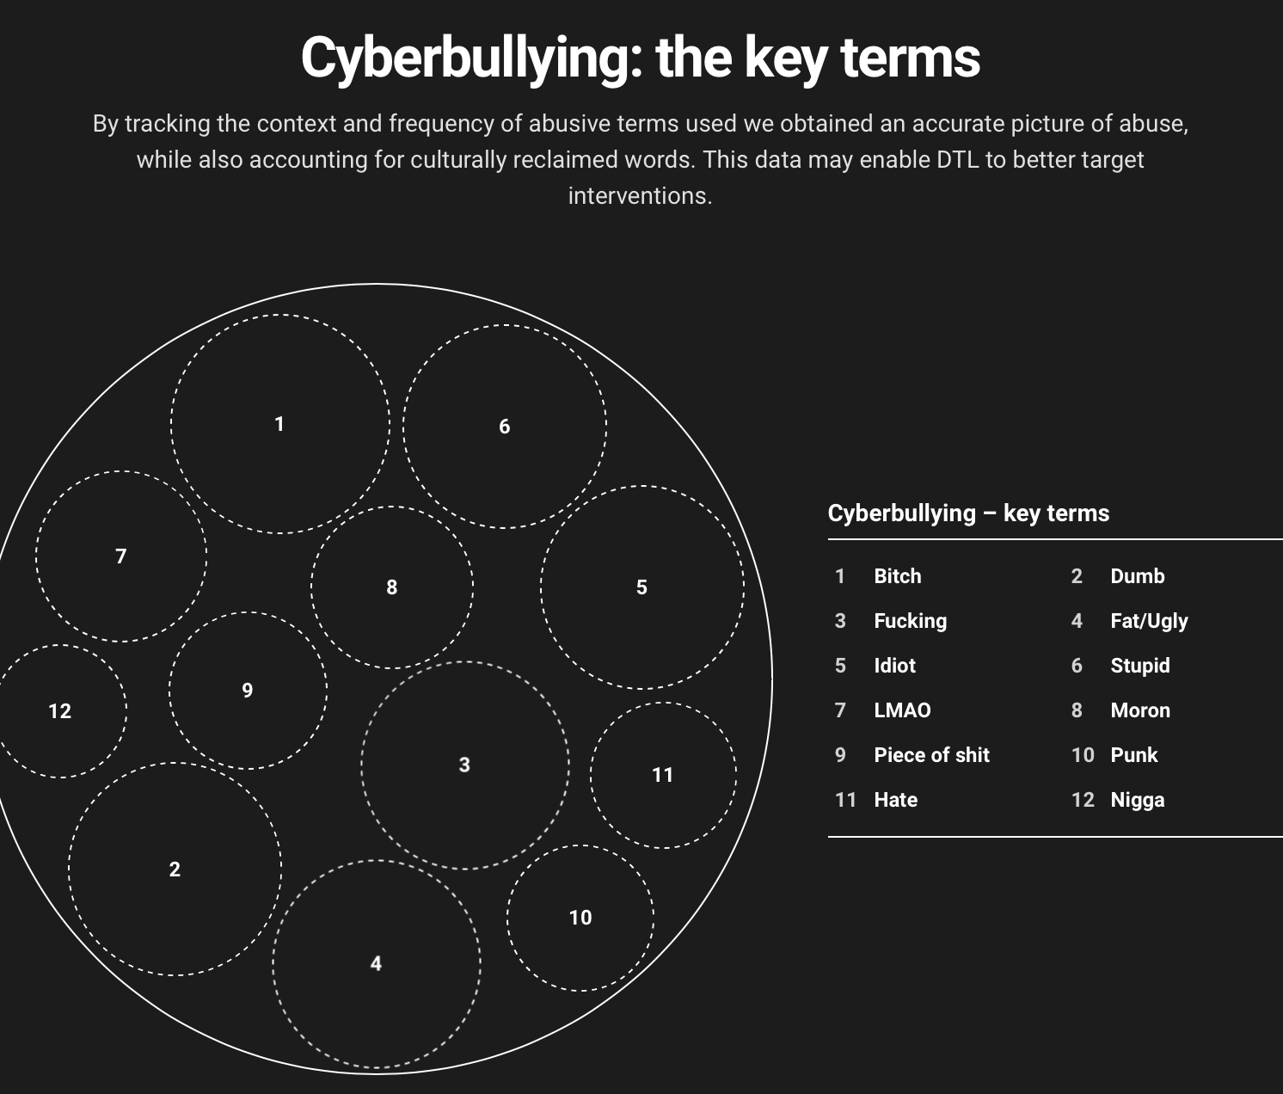
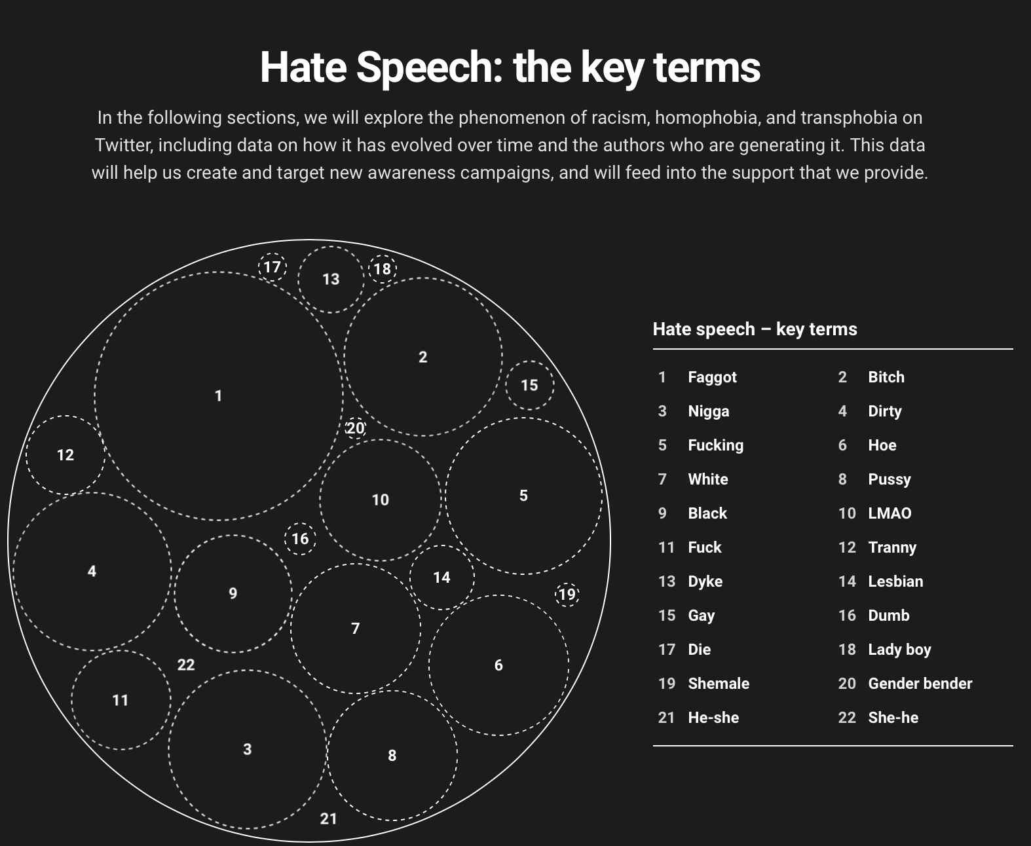
Hate Speech vs. Bullying
“Infographic: Cyberbullying and Hate Speech Online.” Brandwatch. Ditch the Label, 2016. https://www.brandwatch.com/reports/cyberbullying-2016/.
“Hate speech is defined as abuse that directly targets a unique factor beyond the control of the recipient…Hate speech is differentiated from cyberbullying in being defined as abuse directed specifically toward a unique, non-controllable attribute of a group of people” (Infographic: Cyberbullying and Hate Speech Online, 2016)
It is this targeting of out-group identity that differentiates hate speech from more generalized bullying. As seen by the available terms, bullying targets individual identity while hate speech prods and an individual’s alignment with a group be it racial, gender, or sexual orientation.
Notes:
As outlined by the infographic, bullying is the usage of language that is merely hurtful. It is generalized, and often uses words with explicit negative meanings. Hate speech however, is more pointed. It makes specific reference to a individual and the demographic they belong to. There is also the implication of violence that comes with this language. Sometimes the implication of violence is overt, but sometimes it is covert.

Slide 6
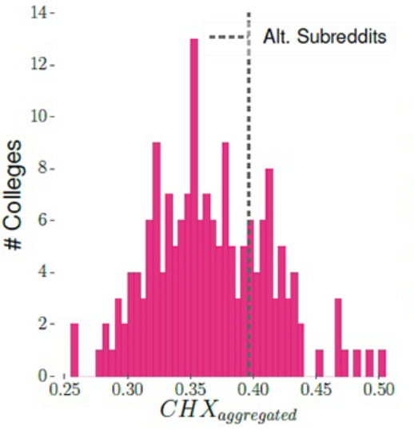
Internet Distribution
“Online hateful speech differs from its offline counterpart in various ways, as a consequence of affordances of online platforms, such as anonymity, mobility, ephemerality, size of audience, and the ease of access. Under the veil of (semi)-anonymity, and the ability to exploit limited accountability that comes with anonymous online activity, perpetrators receive reinforcement from like-minded haters, making hatred seem normal and acceptable” (Saha et al., 2019, p. 256).
“At an aggregate level, we find that hateful speech in college subreddits is indeed prevalent and ranges between 0.26 and 0.51 (mean=0.37; stdev.=0.05)... We find that there are no college subreddits with CHX above 0.51; this reveals reasonable civility in these communities, unlike the banned ones. However, the fact that there are no college subreddits at all with CHX below 0.26 indicates the pervasiveness of the phenomenon” (Saha et al., 2019, p. 259).
Saha, K., Chandrasekharan, E., & De Choudhury, M. (2019). Prevalence and Psychological Effects of Hateful Speech in Online College Communities. Proceedings of the ... ACM Web Science Conference. ACM Web Science Conference, 2019, 255–264. https://doi.org/10.1145/3292522.3326032
Notes:
The internet allows users to hide behind screen names. The anonymity provided by this feature masks a speaker’s identity, making it difficult to discern the context of their speech, or their affiliation with extremist groups, which could otherwise help to decipher whether their language is hate speech or not. Furthermore, hate groups have adapted their lexicon to include words and symbols not readily detected by content moderators, who typically use keyword identification on their platforms. As such, the internet as a distribution platform creates challenges that can make hate speech detection difficult.

Slide 7
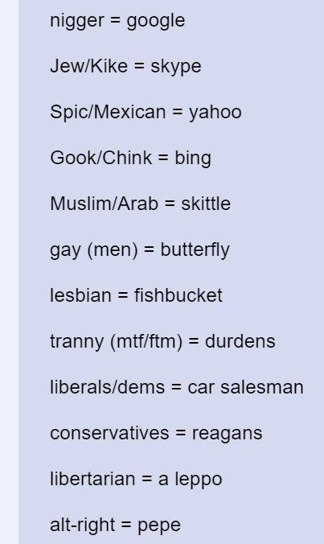
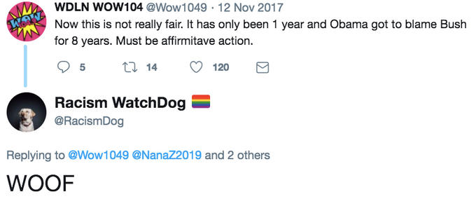
Covert Hate Speech
“Dog whistling refers to the use of words, phrases, and terminology that mean one thing to the public at large, but that carry an additional, implicit meaning only recognized by a specific subset of the audience” (Bhat and Klein, 2020, p. 153).
“The automated removal of explicit insults forces hate groups to use symbols and keywords so as to circumvent these forms of detection. Subsequently, a group of users on 4chan began a loosely organized effort called Operation Google, with the idea of creating a coded language that would circumvent such A.I. systems” (Bhat and Klein, 2020, p. 156).
Image credit: Project Google
Notes:
Covert hate speech is speech whose intention is to target an individual or individuals while appearing to the untrained eye as regular language. As noted above, the highlighted phrases are not inherently inflammatory, yet they bring with them the connotative intention of violence or harm against an oppressed groups, the highlighted bits of rhetoric can be viewed as dog whistles.

Slide 8
Questions?

Slide 9
Psychological Impacts
of Hate Speech
A brief review of the psychological effects of hate speech in both the target and the sender.

Slide 10
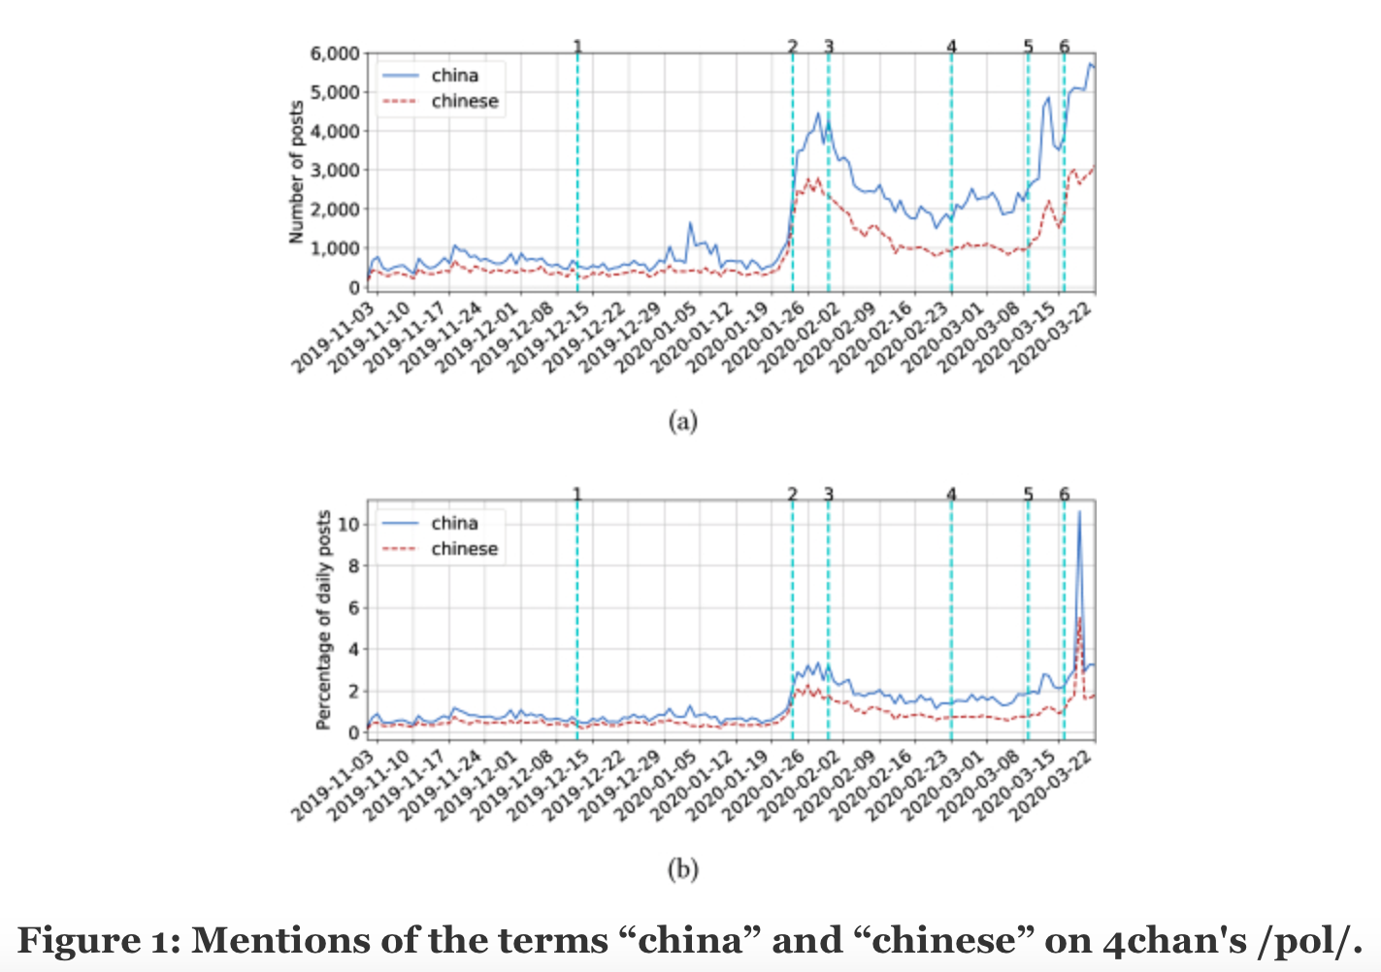
Motives behind hate speech
“We also annotate (with vertical lines) real-world events related to the COVID-19 pandemic (see Table 1 for more details). We first observe a sudden increase in the usage of both words around January 23, 2020, the day the Chinese government officially locked down the city of Wuhan marking the first large-scale effort in China to combat COVID-19 (annotation 2 in Figure 1). After the Wuhan lock-down, the popularity of “china” and “chinese” declines until late February, right around the time that COVID-19 cases started to appear en masse in Europe.”
(Tahmasbi, 2021, p. 1123).
Tahmasbi, Fatemeh, Leonard Schild, Chen Ling, Jeremy Blackburn, Gianluca Stringhini, Yang Zhang, and Savvas Zannettou. “‘Go Eat a Bat, Chang!’: On the Emergence of Sinophobic Behavior on Web Communities in the Face of Covid-19.” Proceedings of the Web Conference 2021, 2021. https://doi.org/10.1145/3442381.3450024.
Notes:
Hate speech often stems from a place of mistrust or even fear of an out-group. Often members of an ingroup will experience hyperviligence in reaction to the threat of an out group, regardless of whether or not this threat is real or perceived. A desire to protect one and ones own is often times the root cause for hate speech, and a foundational point for why certain individuals are more susceptible to hate and radicalization. As pictured in the charts above there was an increase with online hate speech targeting Asian individuals that correlates to increased awareness in the COVID-19 virus, and the perceived correlation between these groups. Though this association was wholly based in misinformation and fear mongering, the perception of a threat garnered just enough outgroup distrust to spur increases in hate and hate speech among members of the ingroup.

Slide 11
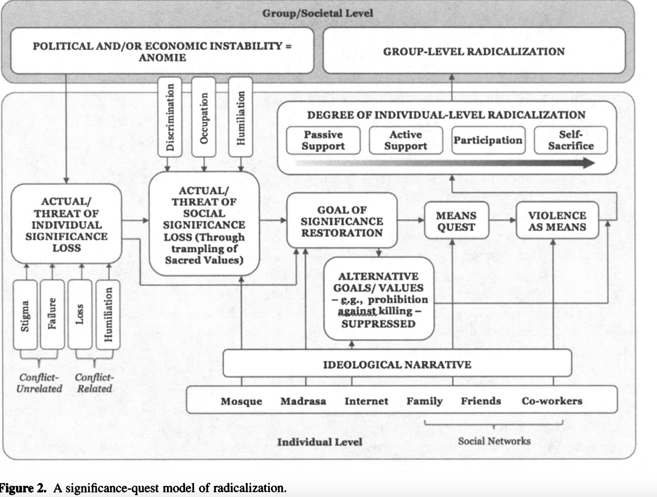
Extremist Identities and Radicalization
“As shown in the central section of figure 2, loss of significance, whether individual or or social in origin, is tied to the means of significance gain/ restoration that of times of in group conflict may be identified as violent struggle (and possibly terrorism) against the group’s nemeses” (Kruglanski et al., 2014, p. 80).
“The bottom part of figure 2 represents the impact of ideology that fuels perception of social significance loss (e.g. by framing historical events in terms of harm perpetrated by a culprit against one’s group and identifying violence against the culprit as a warranted method of response to the presumptive grievance)” (Kruglanski et al., 2014, p. 80).
Kruglanski, A. W., Gelfand, M. J., Bélanger, J. J., Sheveland, A., Hetiarachchi, M., & Gunaratna, R. (2014). The Psychology of Radicalization and Deradicalization: How Significance Quest Impacts Violent Extremism. Political Psychology, 35, 69–93. http://www.jstor.org/stable/43783789
Notes:
The internet functions as a sort of echo chamber, circling and reinforcing extremist ideologies without individuals having to seek out that kind of content. As such, individuals who already feel a sense of unease towards a particular out group may have this unease validated in online spaces, and worse still, be pulled deeper into paths of extremism. It is this sense of unease, combined with ingroup support, that pushes individuals towards actions. Sometimes these actions may be small, such as spewing and posting hateful rhetoric, however individuals may also be encouraged to take more drastic measures, such as committing hate crimes.

Slide 12
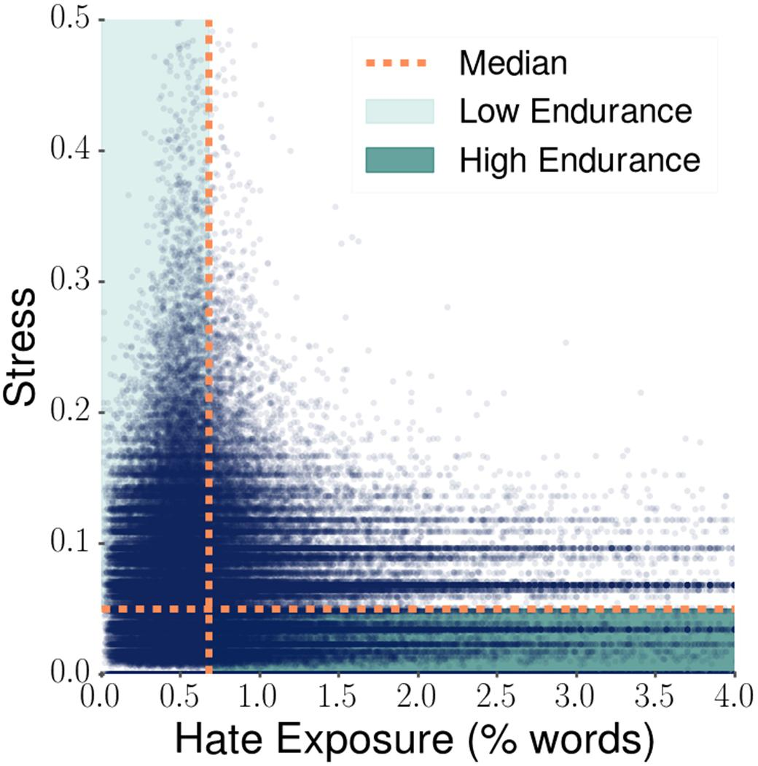
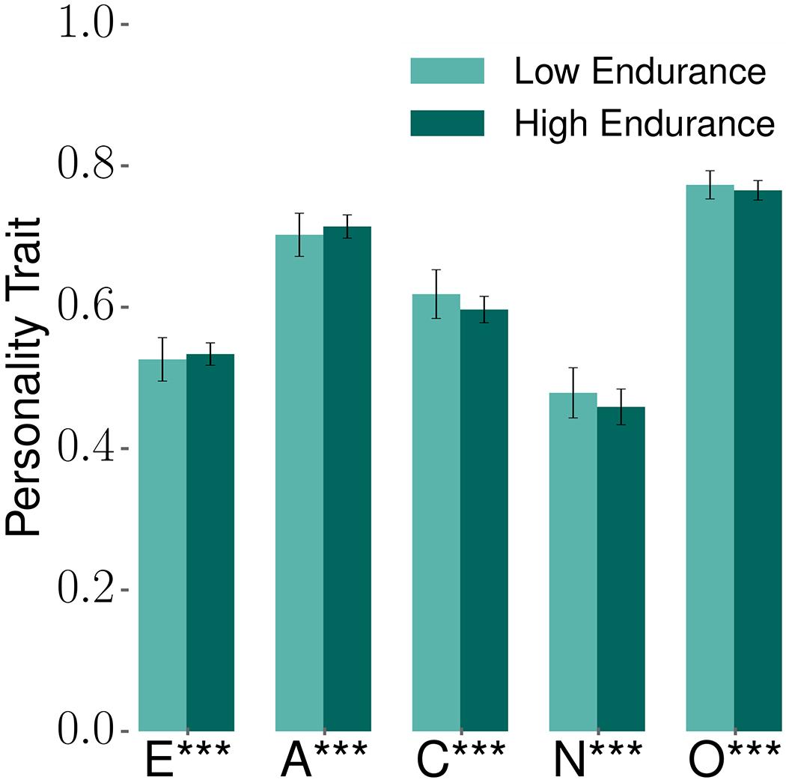
Impacts on Target or Victim
“Besides observing that hate exposure in these communities bears a causal relationship with online stress expressions, we also find that online hate does not affect everybody’s stress expression uniformly. This aligns with the notion that individuals differ in their resilience to the vicissitudes of life” (Saha et al., 2019, p. 260-261)
“The low endurance users also show 4% greater neuroticism (t=89.42) and conscientiousness (t=109.31). Neuroticism indicates the degree of emotional stability and higher values signal increased tendency to experience unpleasant emotions easily” (Saha et al., 2019, p. 261)
Notes:
As outlined by Saha, exposure to hate speech can cause an increase in stress, and it is only through prolonged exposure to such rhetoric that a tolerance may be built up. This puts lower endurance individuals at a higher risk of developing the traits Saha described, namely neuroticism. Doubly interesting, is the high endurance group’s decrease in openness, signifying an increase I n guarded behavior resultant of this prolonged exposure.

Slide 13
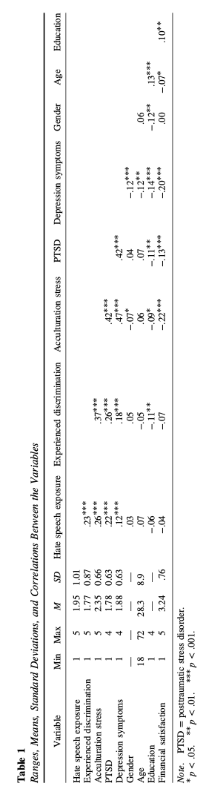
Hypervigilance
“Prolonged experiences of discrimination may also lead to increased vigilance and shape expectations of minority group members regarding possible future discriminatory situations. Because of this, even the very possibility or anticipation of discrimination may constitute a stressor, which in turn may lead to the avoidance of situations in which individuals anticipate that they may be discriminated”
(Wypych and Bilewicz, 2022, p. 2).
Notes:
Prolonged exposure to hate speech also causes hypervigilance in the individual. A symptom typically associated with PTSD, this state of heightened fear and heightened awareness causes difficulty in the individual when it comes to socialization. This cuts the individual off from necessary social circles that could otherwise mitigate the negative impacts of the hate speech exposure. Thus, a sort of self feeding cycle is formed.

Slide 14
Questions?

Slide 15
Datasets
An introduction to the available datasets, and their uses.

Slide 16
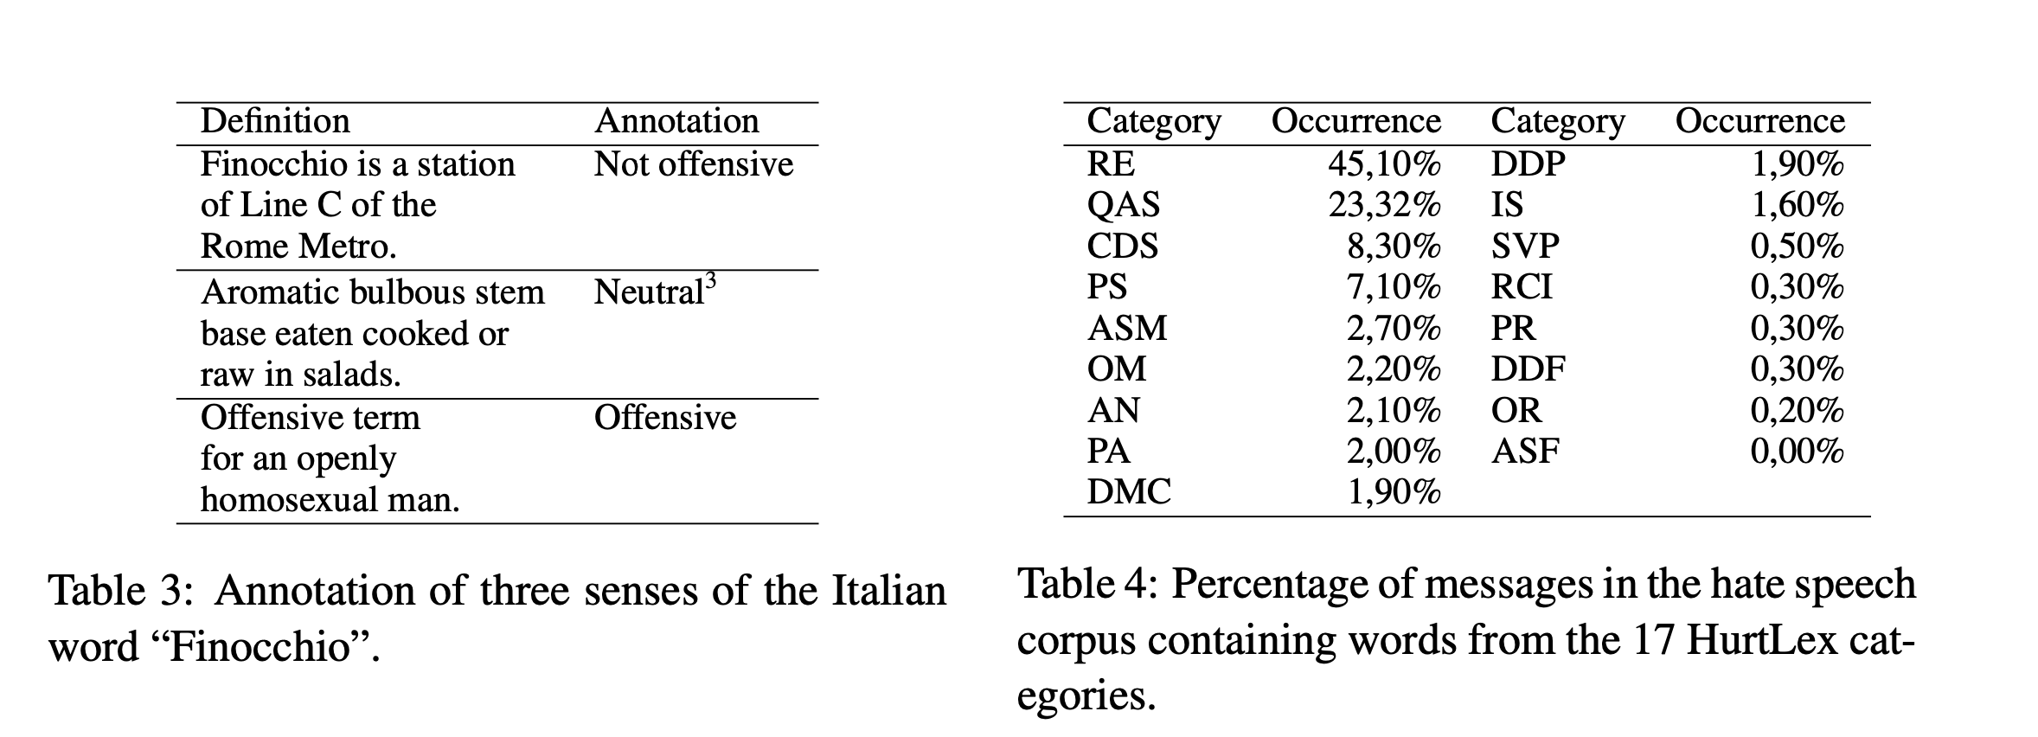
Databases
VOSONsml
The Weaponized Word
Github
Hurtlex
Image:
Bassignana, E., Basile, V., &amp; Patti, V. (2018). Hurtlex: A multilingual lexicon of words to hurt. Proceedings of the Fifth Italian Conference on Computational Linguistics CLiC-It 2018, 51–56. https://doi.org/10.4000/books.aaccademia.3085
Notes:
In order to perform keyword identification, researchers must first establish a lexicon from which they can pull terms. While researchers may use their own prior knowledge, there are a variety of online databases that collect and record hate speech terms. These databases are updated in real time and tend to cover a broader spectrum of language. The image above is pulled from hurtlex, and demonstrates how the database classifies terms, and what percentages these terms occur across an online platform.

Slide 17
Online Exploration
Explore the Hatebase database at www.hatebase.org
Get to know how it operates, including how to search for and find specific terms and their definitions. Practice using the search filters and citation links. This will be useful for the upcoming activity.

Slide 18
Machine Learning Models
An overview of machine learning models and their uses within the context of hate speech research.

Slide 19
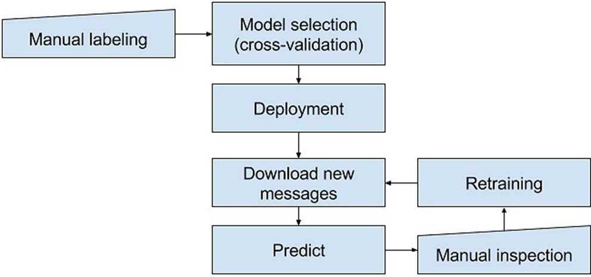
Inclusion of Machine Learning Models
“After the manual screening phase, the generated new samples were used to retrain the hate speech detection model (see Figure 2)… The model predictions, however, were improved by retraining it during the monitoring phase. In the end, only 205 out of a total dataset of 26,618 posts were classified as hate speech by the machine learning system” (Laaksonen et al., 2020, p. 9).
Notes:
Machine learning models can be especially helpful for identifying hate speech across an online platform. As noted above, researchers have the ability to teach models to perform keyword recognition using an established lexicon. With trials and re-trainings, researchers are able to establish more robust patterns of recognition within the machine learning model, training it to do more advance recognition on more nuanced language, and otherwise provide additional information pertaining to the identity and affiliation of the speaker.

Slide 20
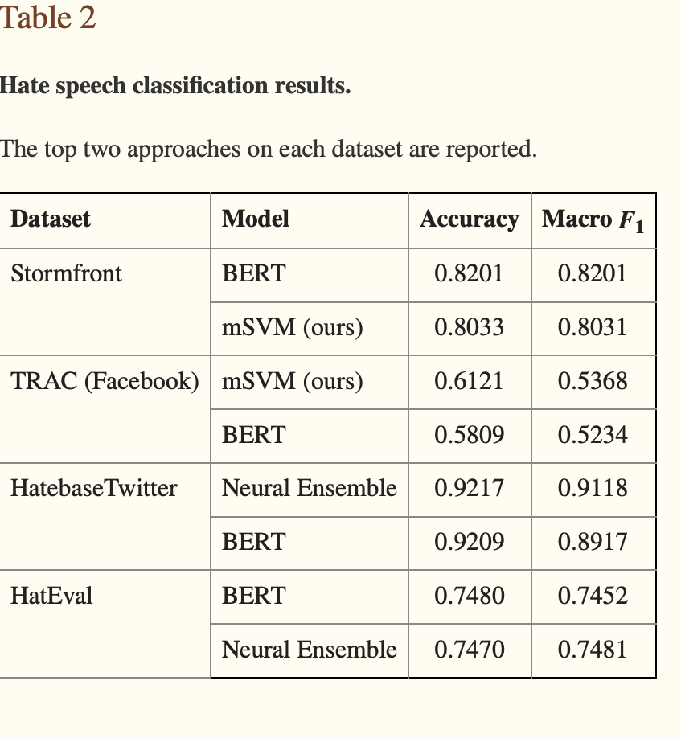
Limitations
“We present attention visualizations from BertViz for the trained BERT model on the mis-classified forum post “I don’t think anyone is insinuating that we are equal to non whites, or that we would ignore white nations.” (this post does not satisfy the authors’ conditions for hate speech, but the BERT model classified it as hateful) (MacAvaney, 2019, p. 11).”
“A challenge faced by automatic hate speech detection systems is the changing of attitudes towards topics over time and historical context” (MacAvaney, 2019, p. 13).
Notes:
There are some limitations that come with this sort of work. As hate speech is highly contextual, there will be some instances of hate speech that can not be feasibly perceived by a machine learning model, as these instances of hateful rhetoric are defined by the context in which they are spoken, Over and under flagging is an issue for these models, thus keyword identification should also come at the discretion of the researcher who can bring their own contexts, and decipher the more nuanced, or covert, instances of hate speech.

Slide 21
Activity
Using the database, Hatebase, students will be asked to examine fragments of language from existing conflicts from around the world.
Using the terms compiled in the database, students should be able to distinguish which fragments of language constitute hate speech, identify who the speech is intended to target, and what sort of damage the speech inflicts upon its recipients.
Students should take notes of their findings and prepare to report to the class.
Notes:
Assignment 1 - Coded Language is the intended activity described here.

Slide 22
Works Cited
Bassignana, E., Basile, V., &amp; Patti, V. (2018). Hurtlex: A multilingual lexicon of words to hurt. Proceedings of the Fifth Italian Conference on Computational Linguistics CLiC-It 2018, 51–56. https://doi.org/10.4000/books.aaccademia.3085
Bhat, P., Klein, O. (2020). Covert Hate Speech: White Nationalists and Dog Whistle Communication on Twitter. In: Bouvier, G., Rosenbaum, J. (eds) Twitter, the Public Sphere, and the Chaos of Online Deliberation. Palgrave Macmillan, Cham. https://doi.org/10.1007/978-3-030-41421-4_7
“Infographic: Cyberbullying and Hate Speech Online.” Brandwatch. Ditch the Label, 2016. https://www.brandwatch.com/reports/cyberbullying-2016/.
Kruglanski, A. W., Gelfand, M. J., Bélanger, J. J., Sheveland, A., Hetiarachchi, M., & Gunaratna, R. (2014). The Psychology of Radicalization and Deradicalization: How Significance Quest Impacts Violent Extremism. Political Psychology, 35, 69–93. http://www.jstor.org/stable/43783789
Laaksonen, S.-M., Haapoja, J., Kinnunen, T., Nelimarkka, M., &amp; Pöyhtäri, R. (2020). The datafication of hate: Expectations and challenges in automated hate speech monitoring. Frontiers in Big Data, 3. https://doi.org/10.3389/fdata.2020.00003
MacAvaney S, Yao H-R, Yang E, Russell K, Goharian N, Frieder O (2019) Hate speech detection: Challenges and solutions. PLoS ONE 14 (8): e0221152. https://doi.org/10.1371/journal. pone.0221152
Saha, K., Chandrasekharan, E., & De Choudhury, M. (2019). Prevalence and Psychological Effects of Hateful Speech in Online College Communities. Proceedings of the ... ACM Web Science Conference. ACM Web Science Conference, 2019, 255–264. https://doi.org/10.1145/3292522.3326032
Tahmasbi, Fatemeh, Leonard Schild, Chen Ling, Jeremy Blackburn, Gianluca Stringhini, Yang Zhang, and Savvas Zannettou. “‘Go Eat a Bat, Chang!’: On the Emergence of Sinophobic Behavior on Web Communities in the Face of Covid-19.” Proceedings of the Web Conference 2021, 2021. https://doi.org/10.1145/3442381.3450024.
Wypych, M.,& Bilewicz, M. (2022,January 31). Psychological Toll of Hate Speech: The Role of Acculturation Stress in the Effects of Exposure to Ethnic Slurs on Mental Health Among Ukrainian Immigrants in Poland. Cultural. Diversity and Ethnic Minority Psychology. Advance online publication. http://dx.doi.org/10.1037/cdp0000522

